Slide 1

JAVA project
(Final term)
Topic : Student Portal Simulator

Slide 2
Presented by :
Group-11
(Data Noobs)
Members :
1) Mahmudul Hasan (20-41876-1) (JAVA-CC)
2) Muhammad Shahriar Zaman
(20-41840-1) (JAVA-CC)

Slide 3
Objectives Of Our Presentation
1) Introduction to our project topic
Brief summary of our project
Illustration of our project using diagrams

Slide 4
Introduction
We will create a student portal system which will specialize in semester and course based results. It will include many additional features.

Slide 5
Summary
Our java project will simulate a student portal e.g.(AIUB). Students will be able to log into their respective accounts, and view results. The program will calculate CGPA Accurately based on cumulative data.

Slide 6
Marks will be put by the faculty. A single Admin will be able to regulate everything.

Slide 7
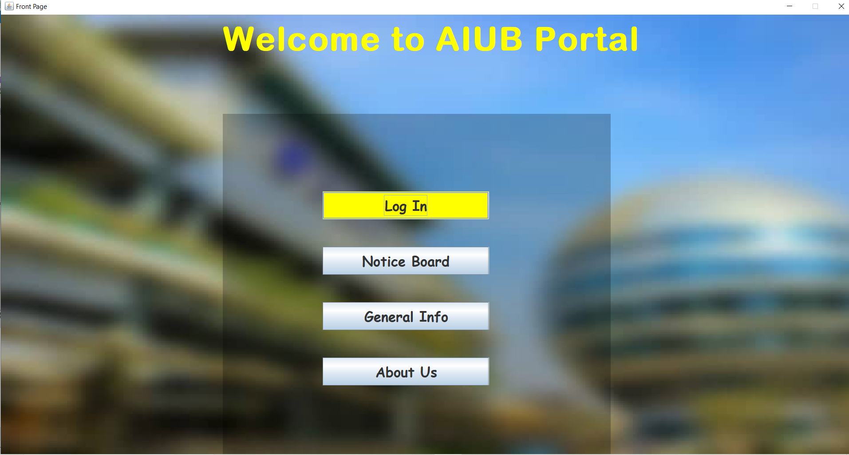
Front Page of the Project

Slide 8
Student Account Features

Slide 9
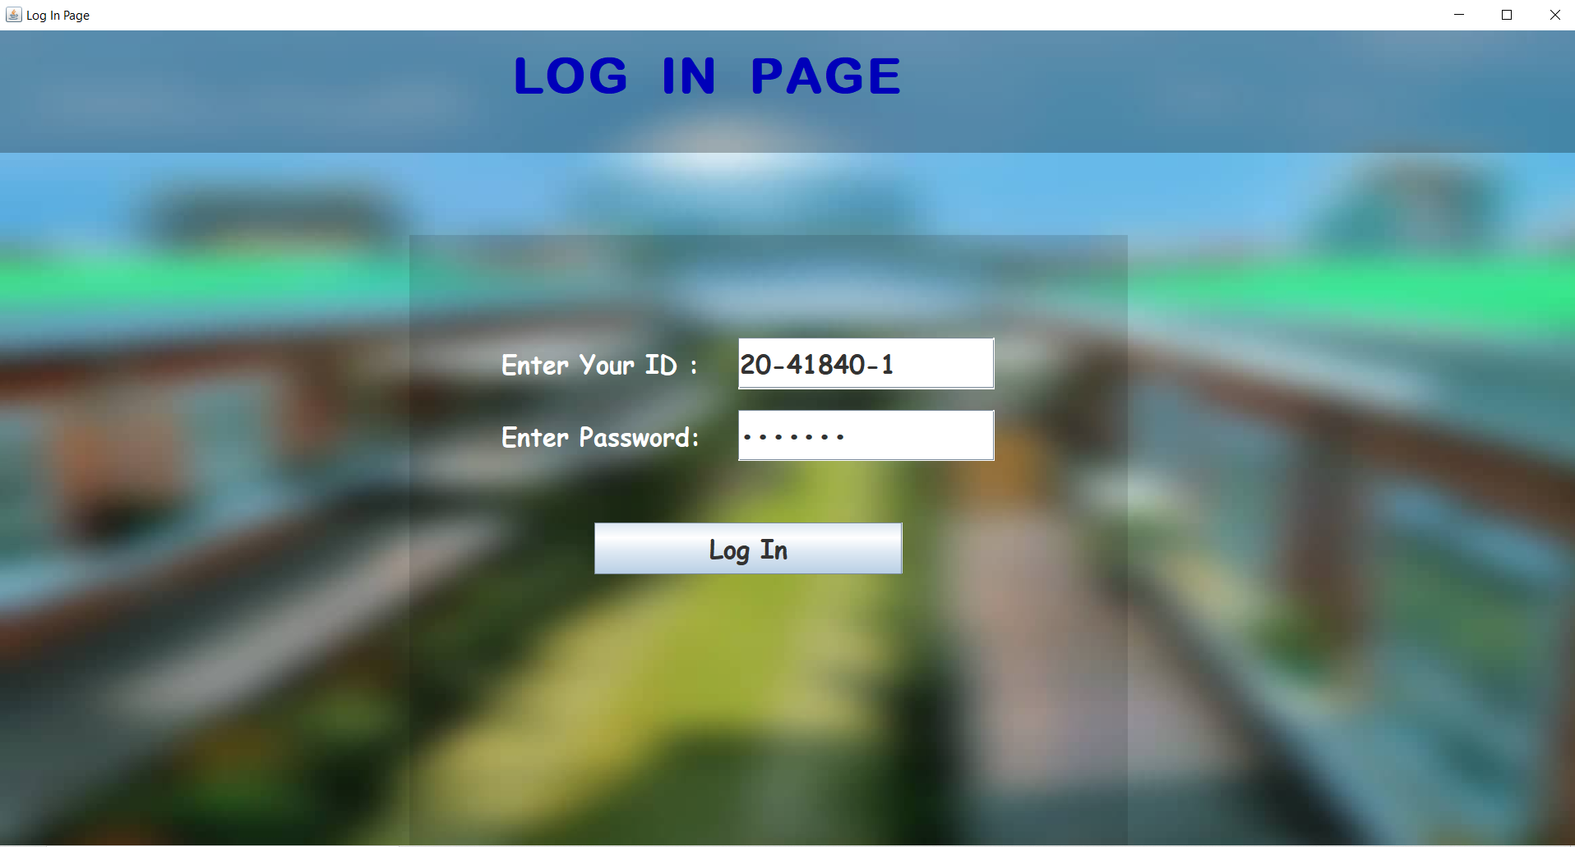
Logging Into Student ID

Slide 10
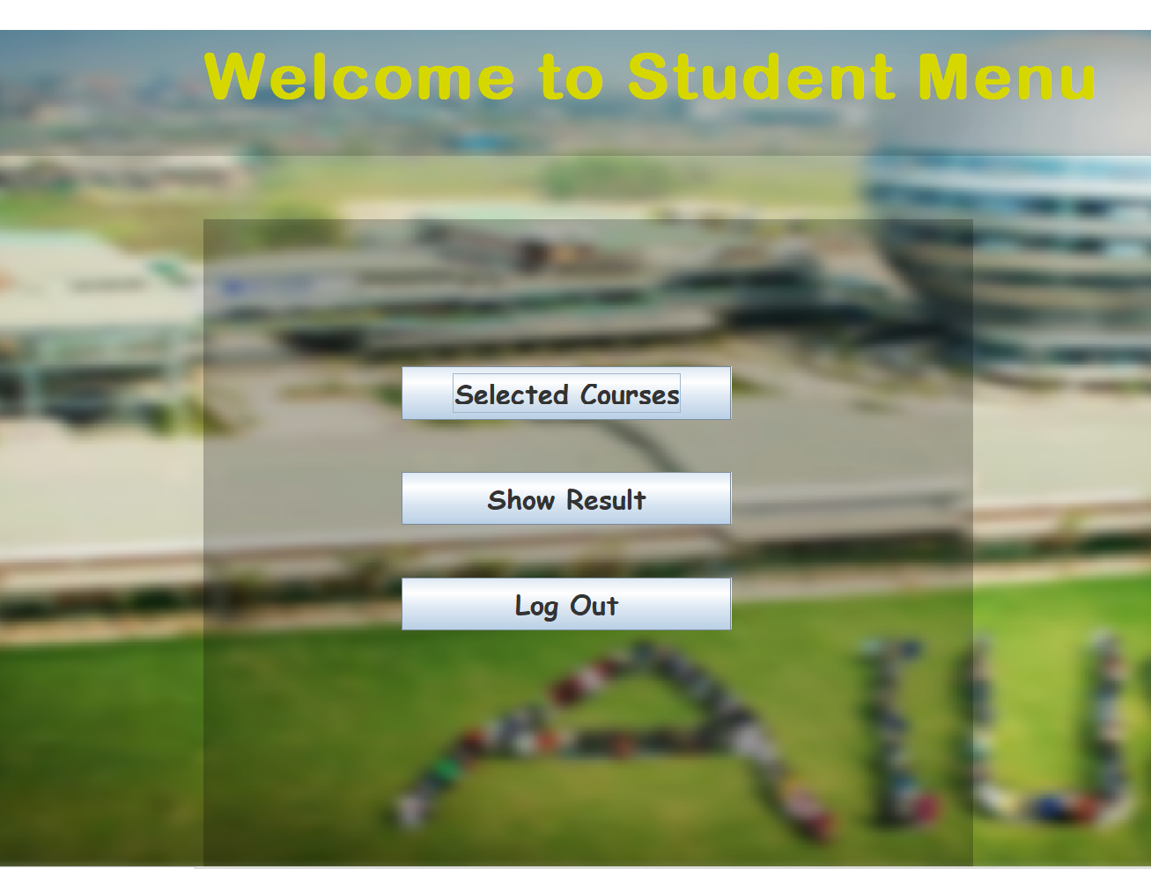
Student Account Features

Slide 11
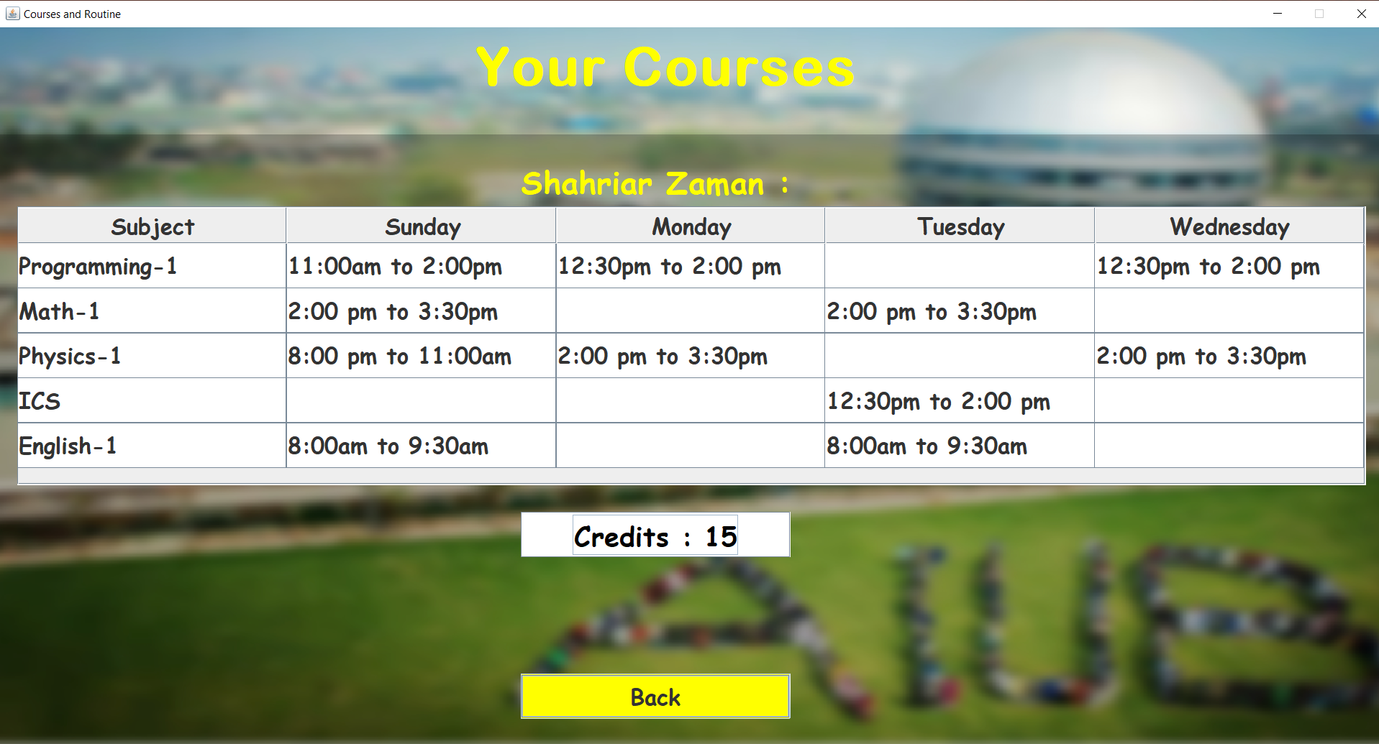
Selected Courses and Routine

Slide 12
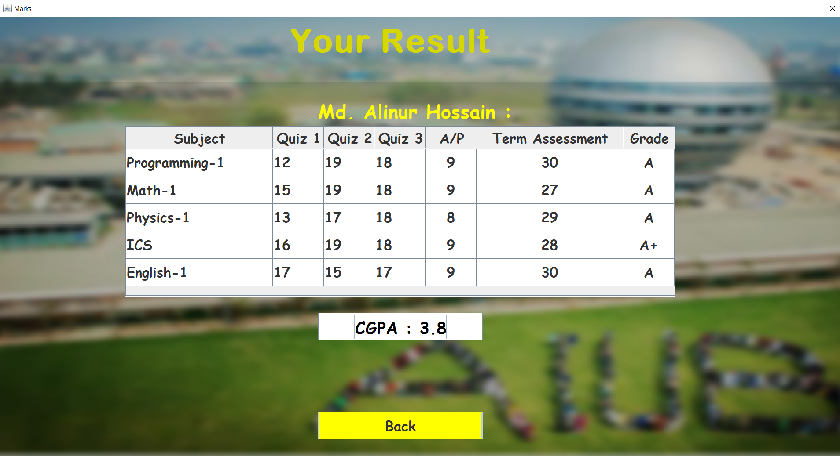
Semester Result with Grade and GPA

Slide 13
Faculty Account Features

Slide 14
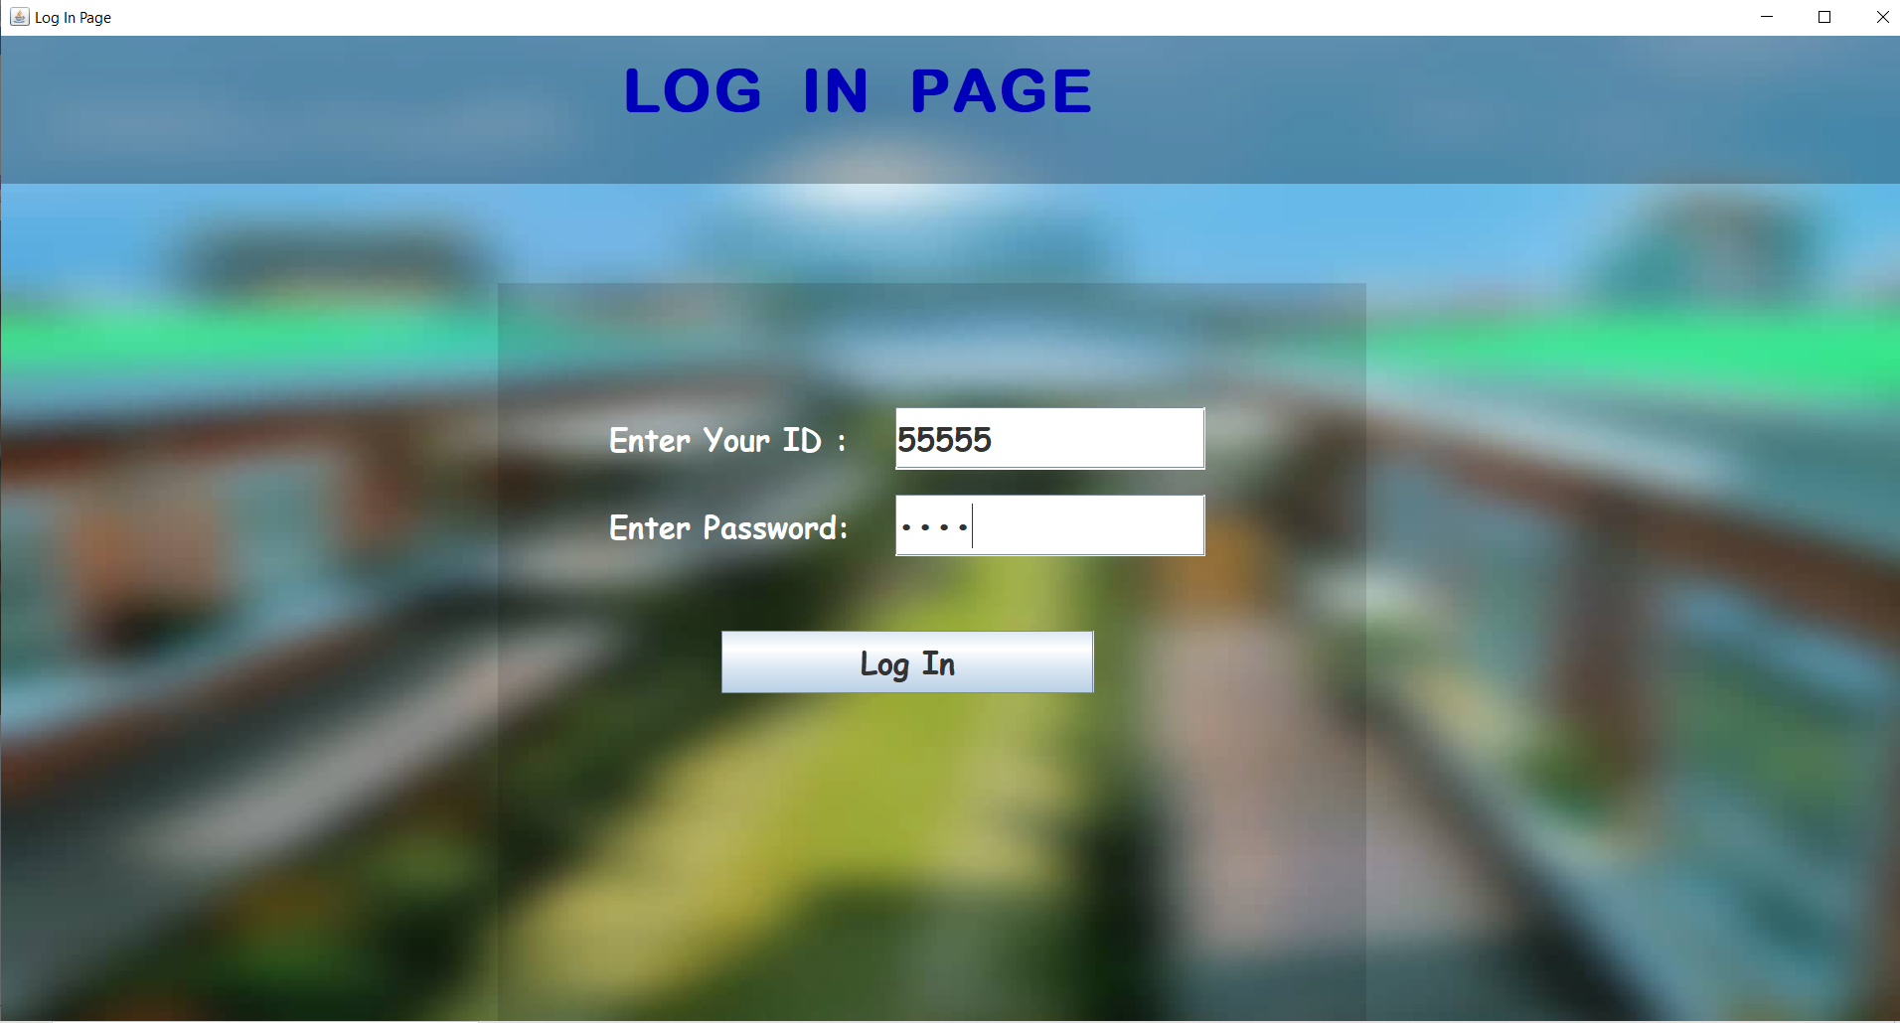
Faculty Member Logging In Successfully

Slide 15
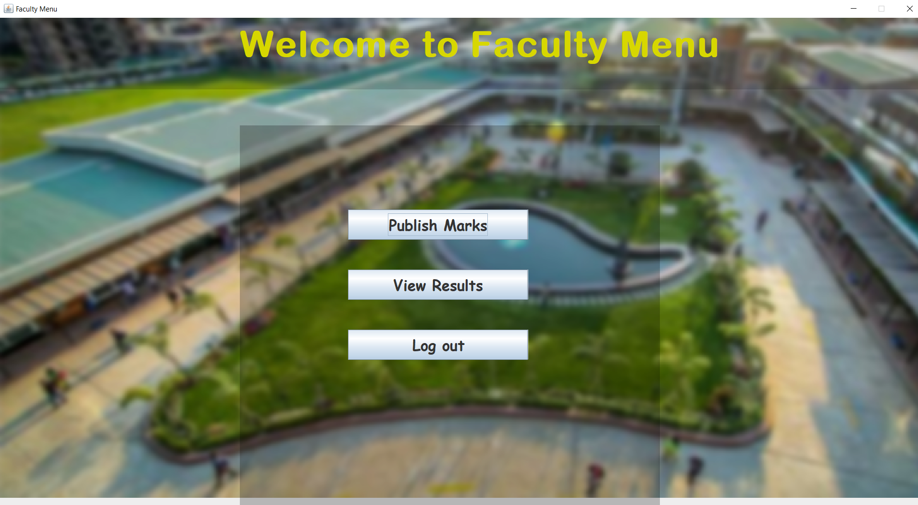
Faculty Menu

Slide 16
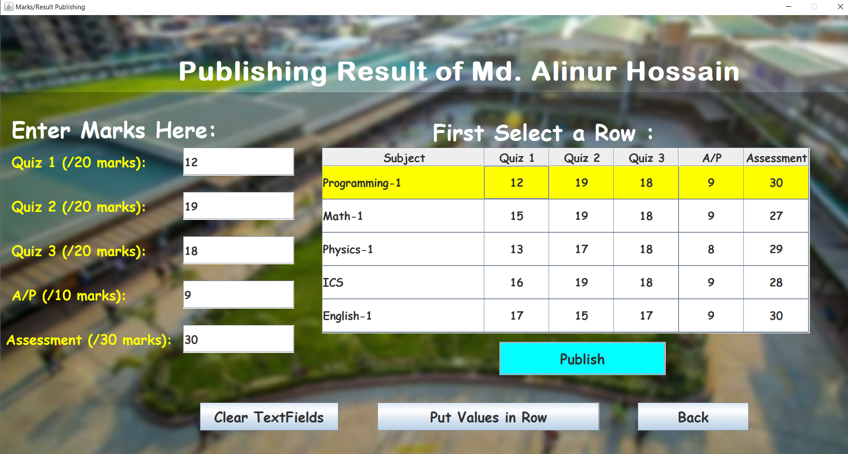
Faculty Entering respective marks of a student, the marks and their fields can be edited in many ways

Slide 17
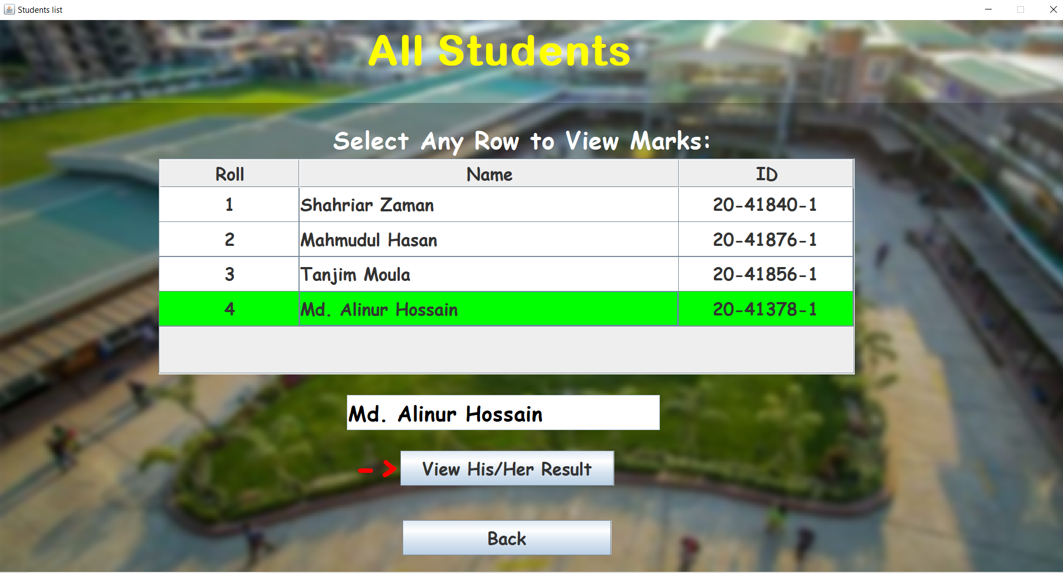
Faculty Selecting a Student to view His/Her marks

Slide 18
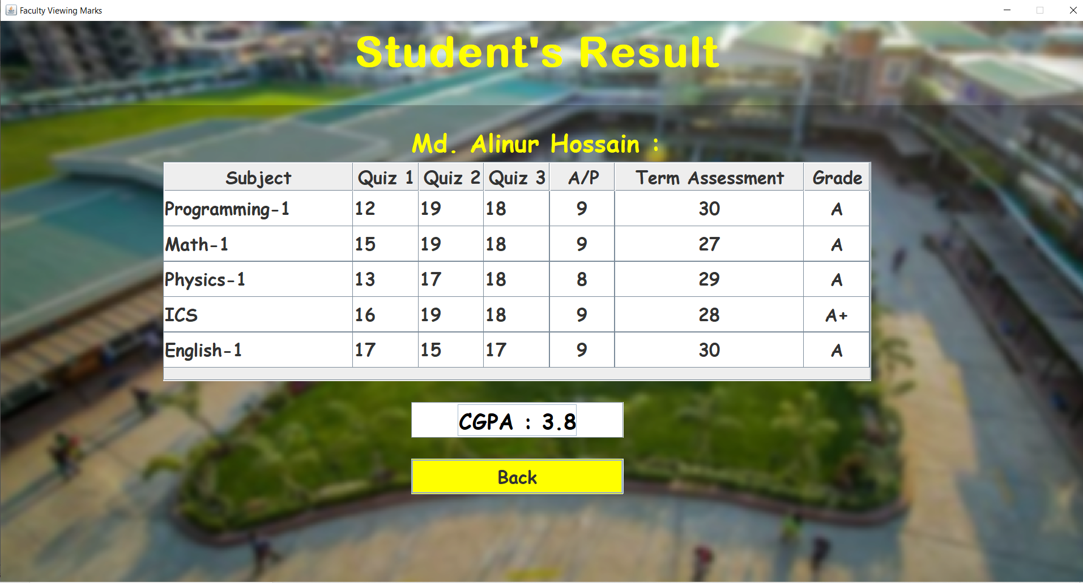
Faculty Viewing a Student’s marks

Slide 19
Admin Account Features

Slide 20

Admin Logging In Successfully,

Slide 21
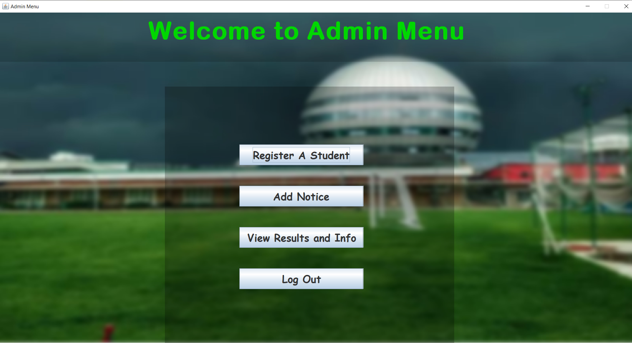
Admin Menu

Slide 22
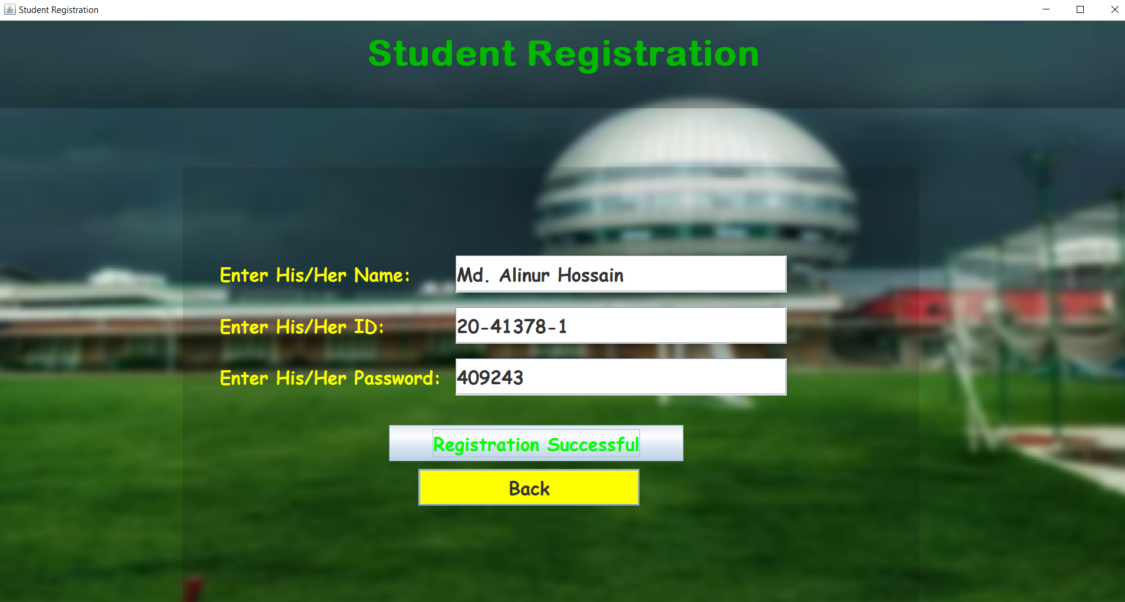
Admin conducting admission of a new student

Slide 23
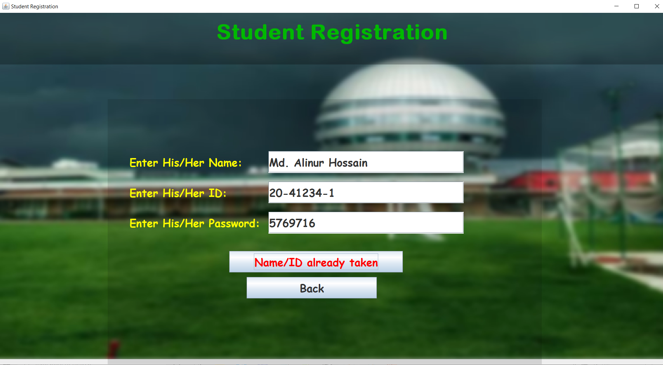
Multiple students cannot be registered with the same Name or ID.

Slide 24
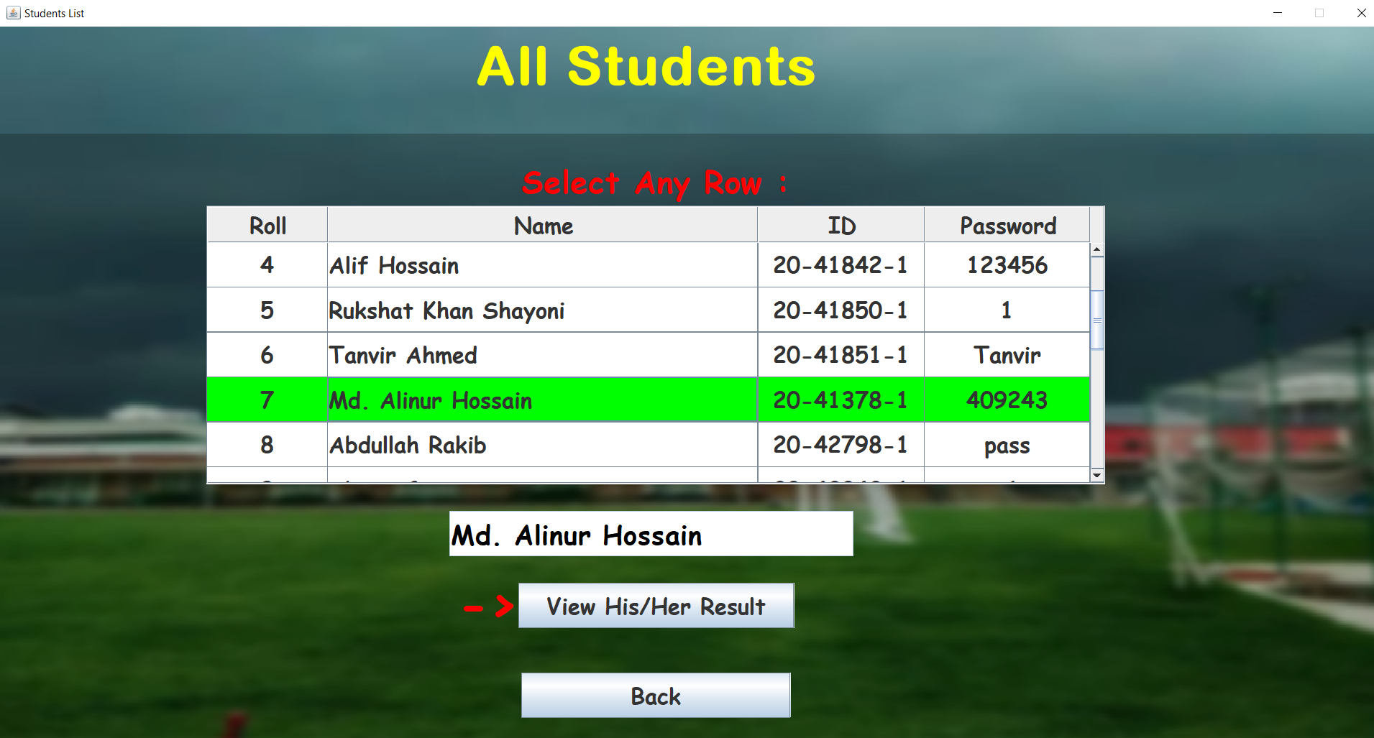
Viewing Student Information.

Slide 25
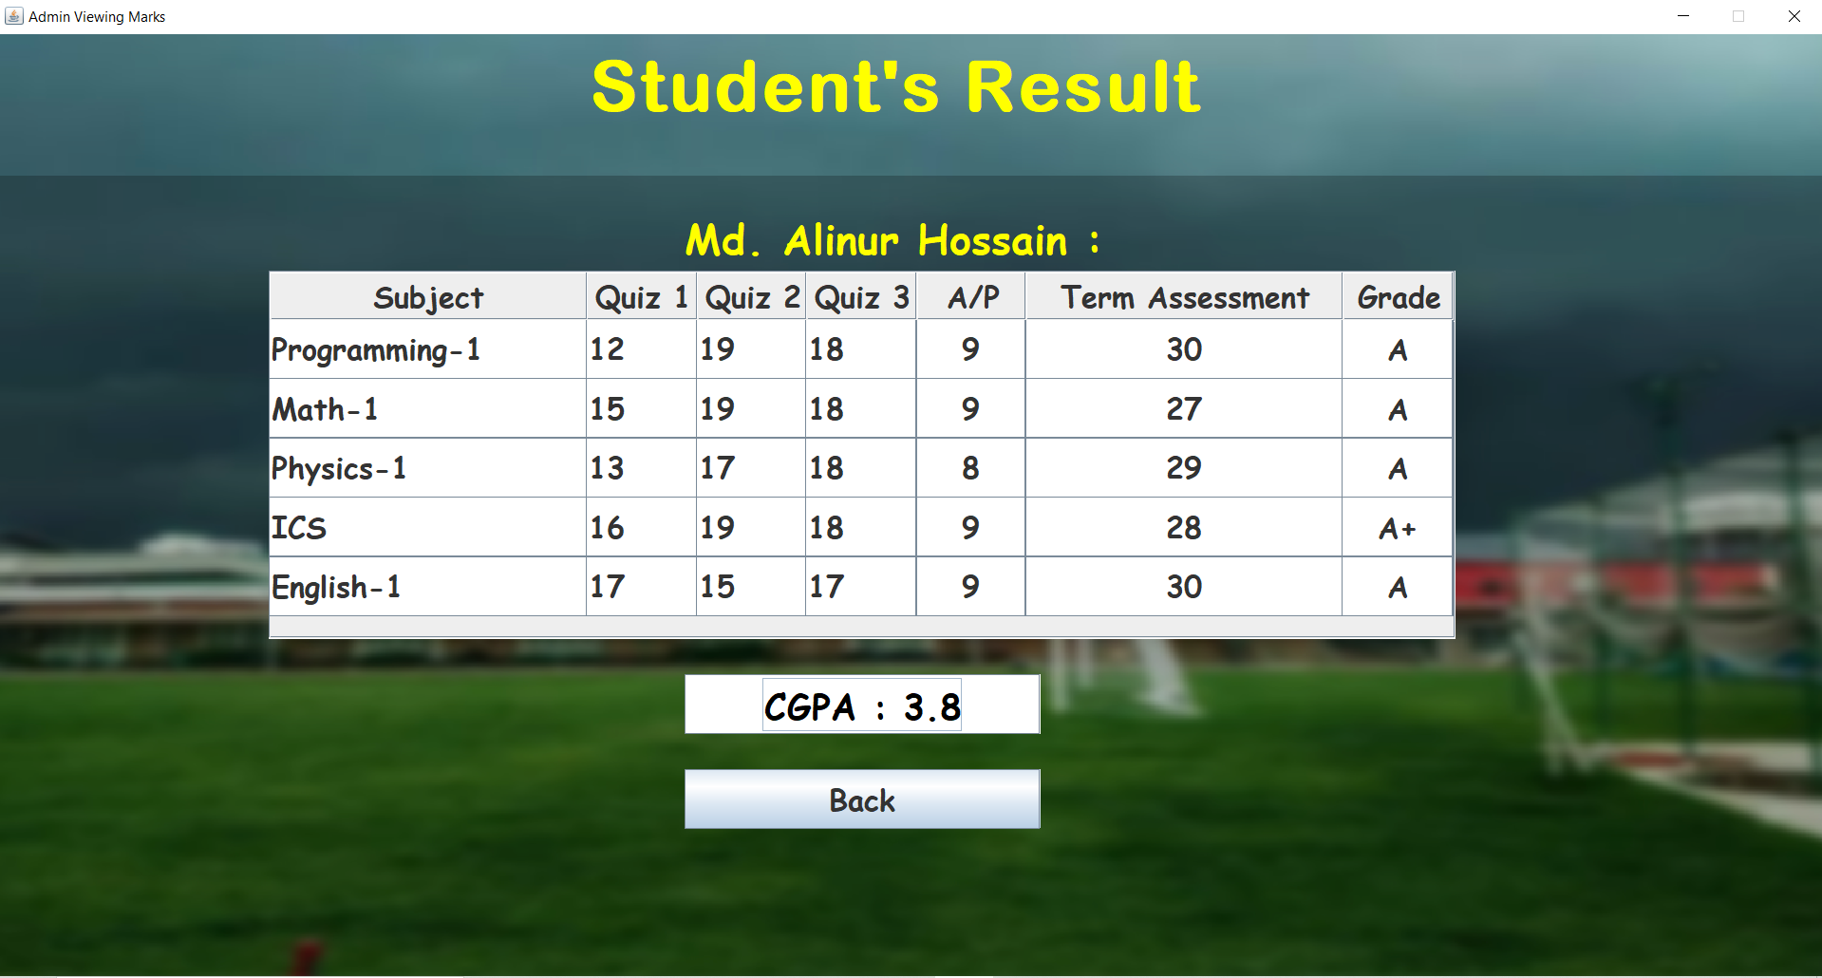
Viewing result of selected student.

Slide 26
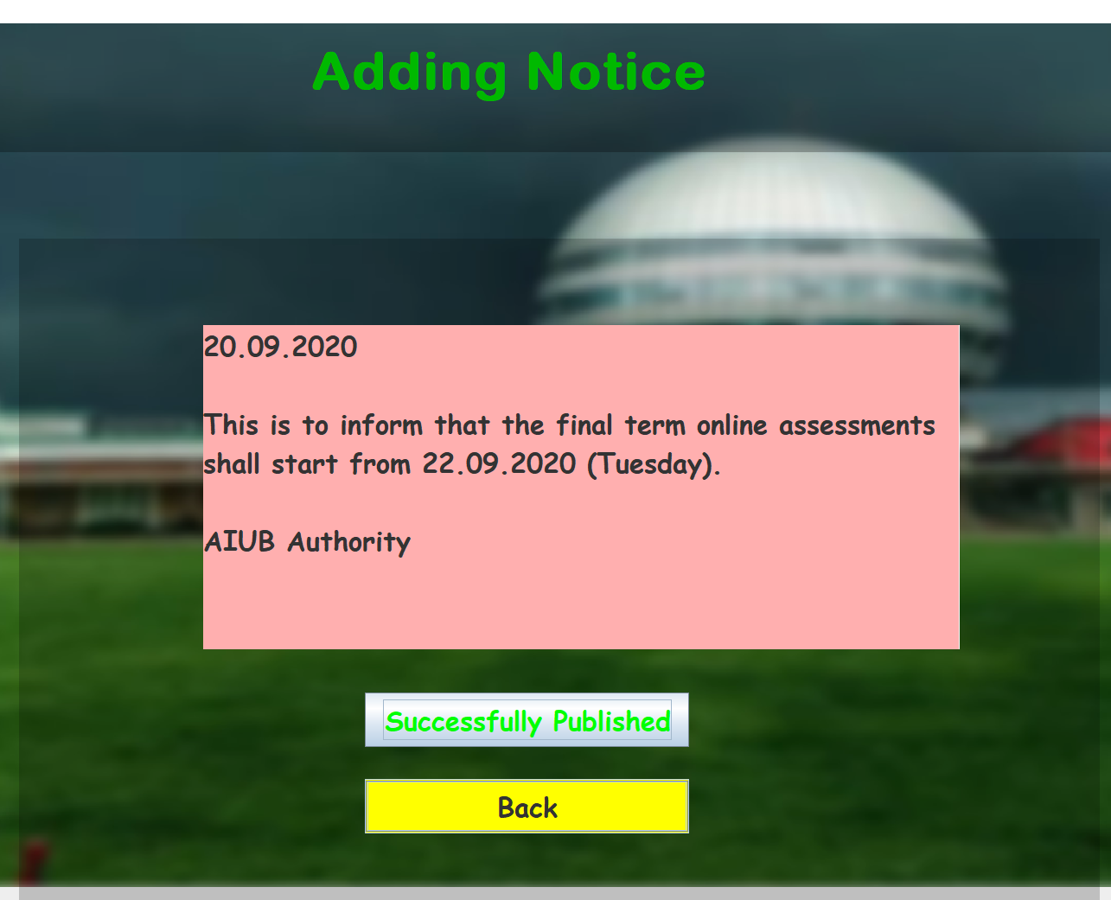
The Admin can write and Publish Notices.

Slide 27
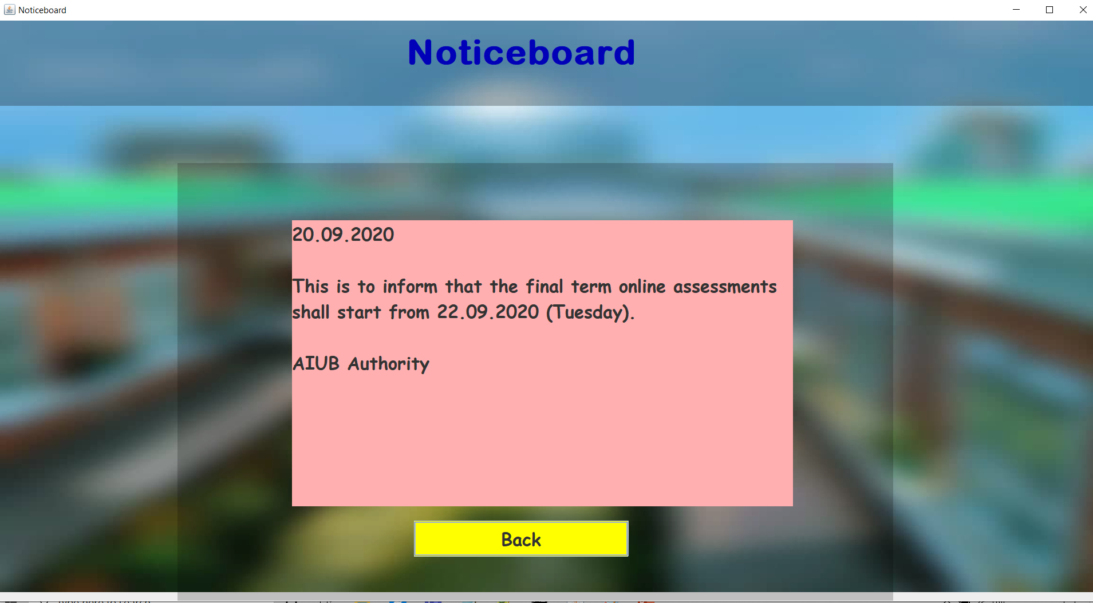
Notice published on Noticeboard

Slide 28
General Information

Slide 29
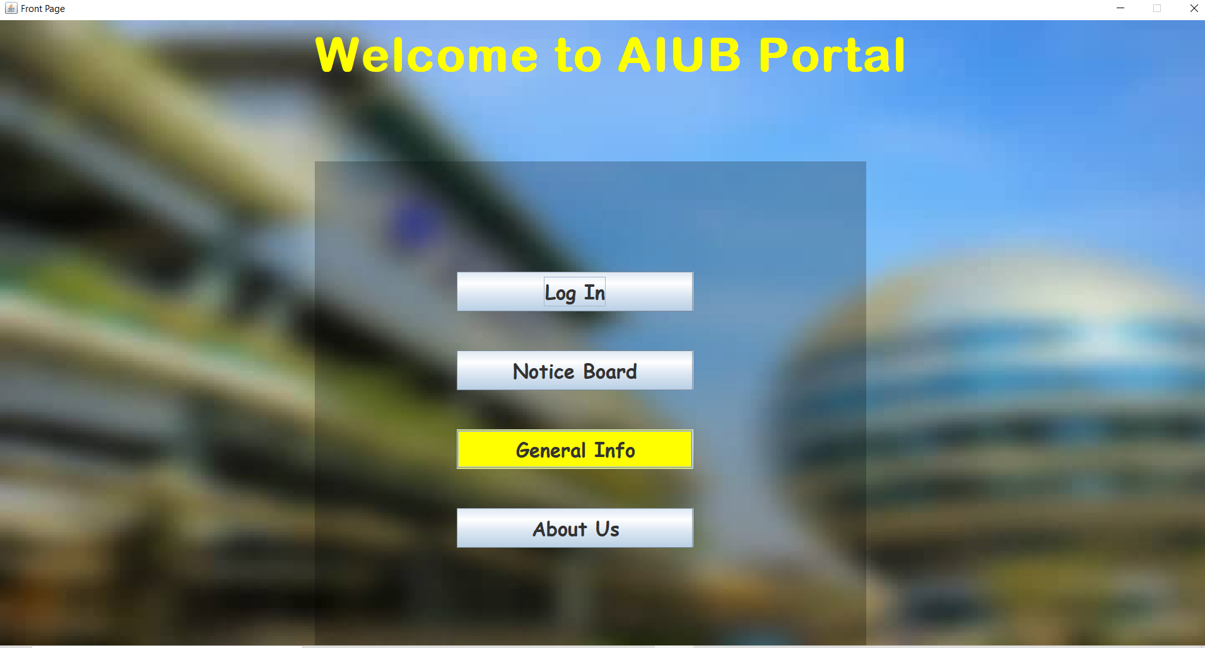
We have put additional features such as a General Information Desk. The user can also view the developers.

Slide 30
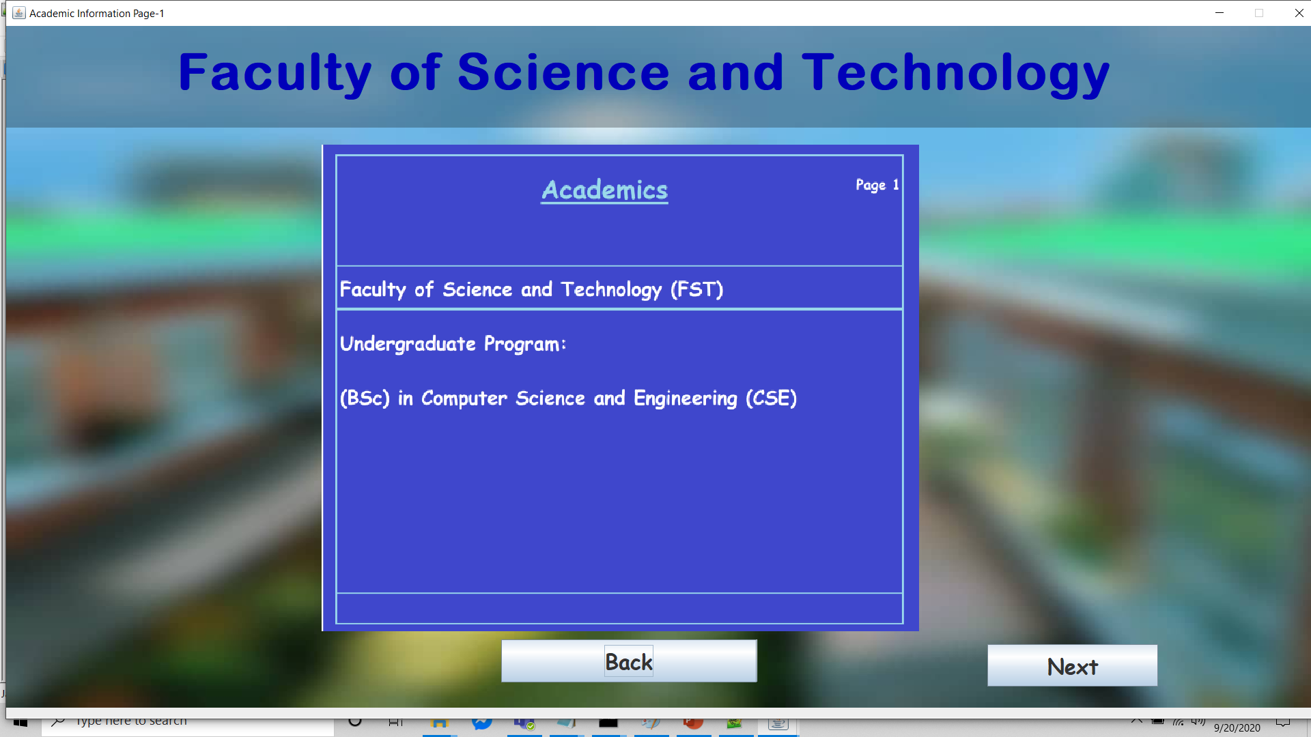

Slide 31
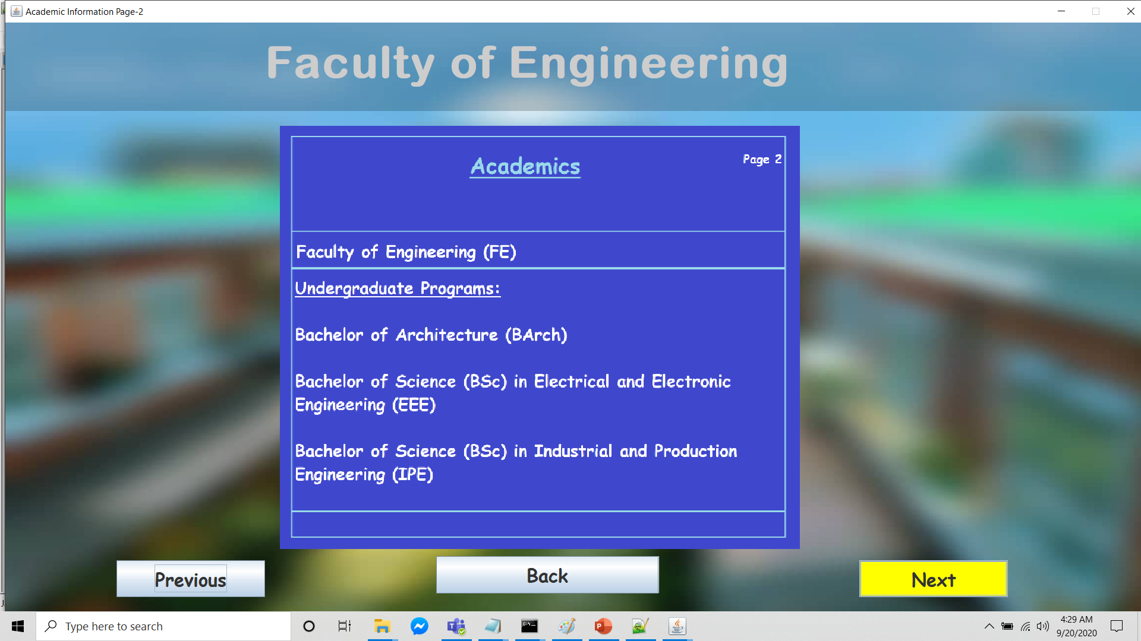

Slide 32
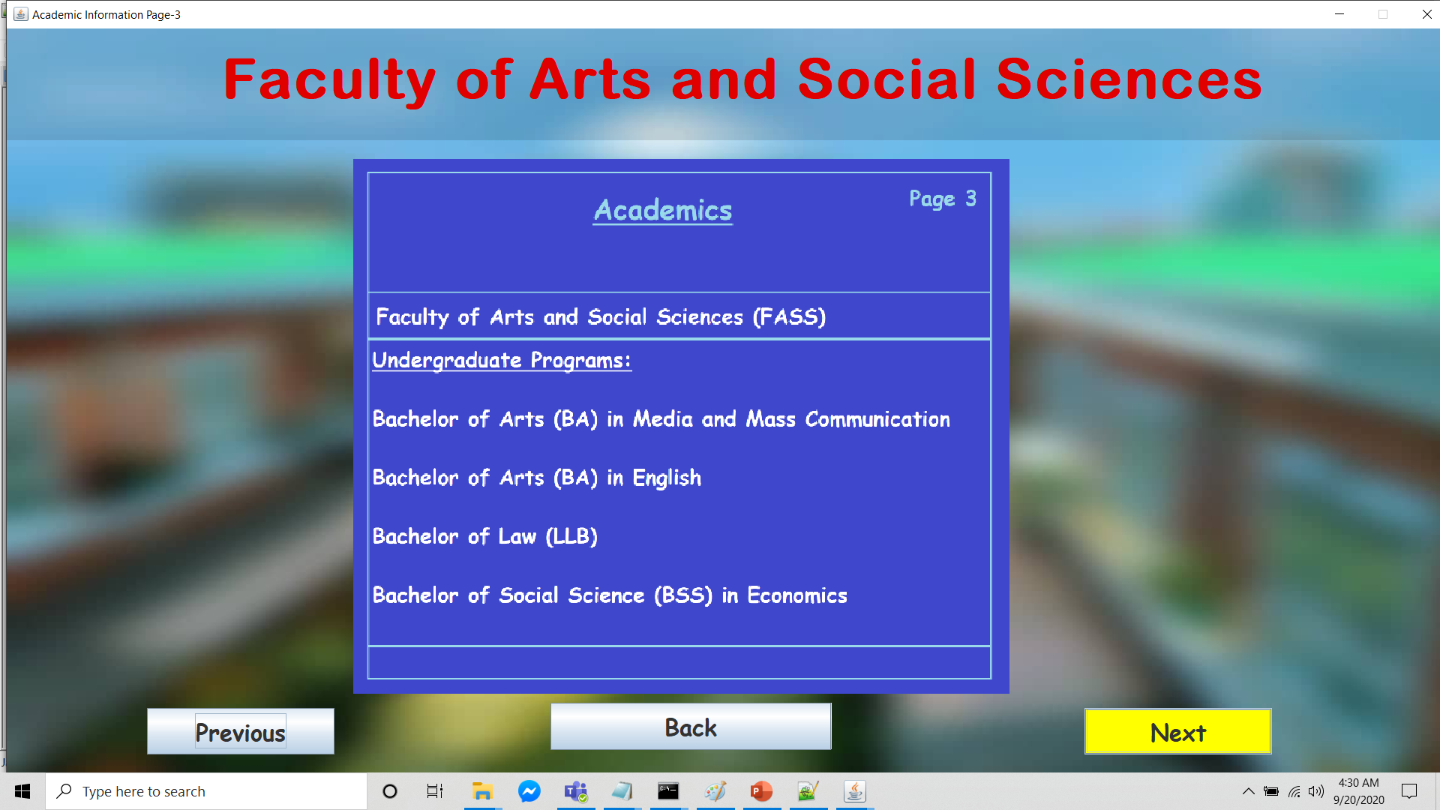

Slide 33
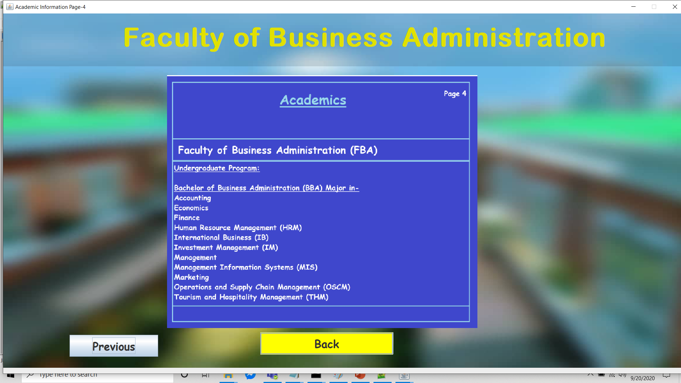

Slide 34
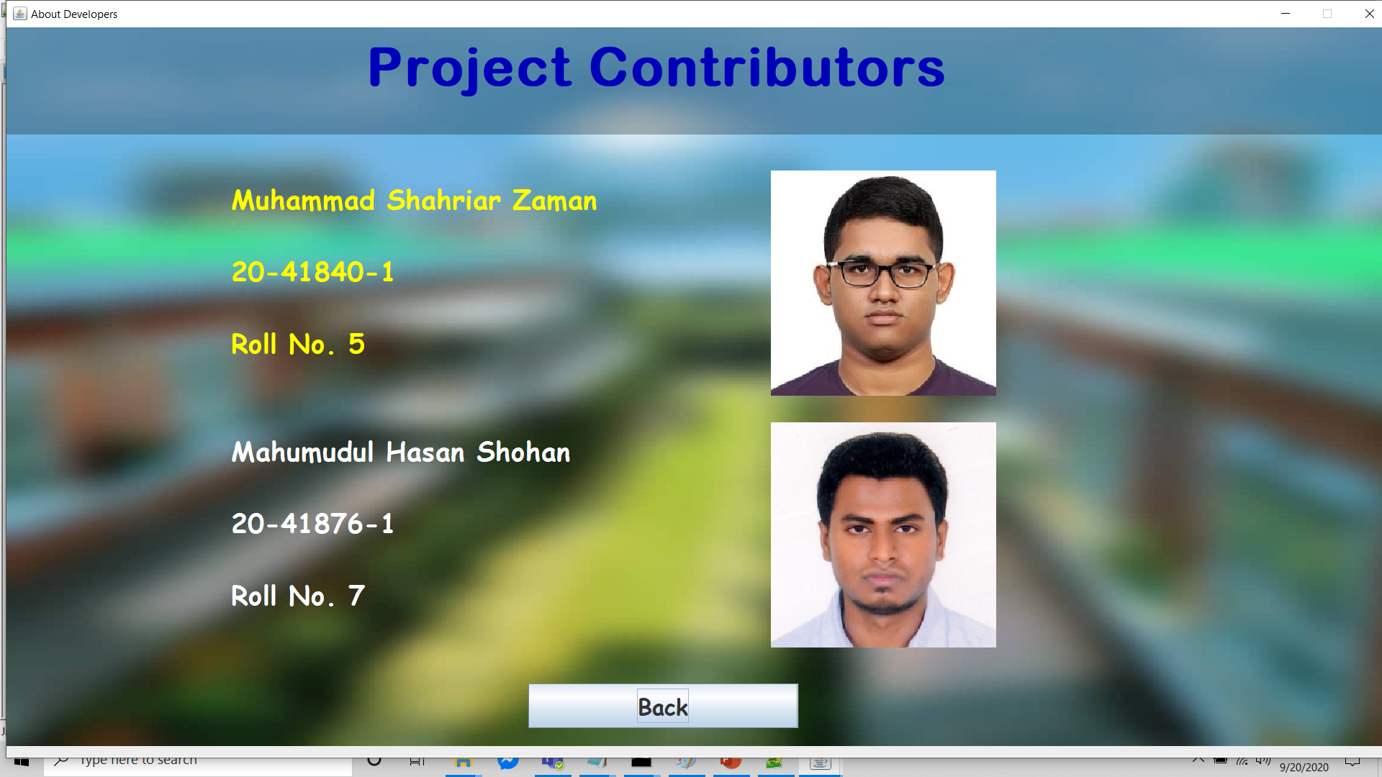
About Us

Slide 35
Thank You For Your Attention

